Slide 1


Enabling systemic change
Day 2 Welcome Address · 8 September 2026
CoARA Conference 2026 · CNRS Auditorium, Paris
Dr Yensi Flores Bueso · Global Young Academy
Notes:
For technical issues, feel free to contact Secretariat in the chat

Slide 2
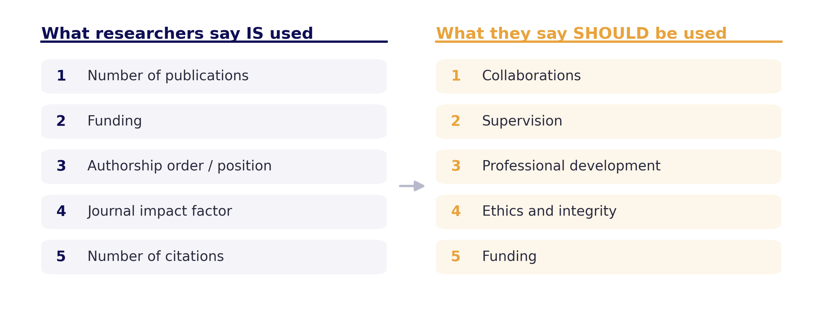
The mandate already exists
Helmholtz Open Science Office researcher survey, n = 1,145, 18 centres, 2025 — unpublished. Criteria framework adapted from Lim BH, D'Ippoliti C, Dominik M et al. (2025).

Slide 3
Four enablers.
Each exists somewhere.
None exists everywhere.
Closing that gap is what the next phase is for.

Slide 4
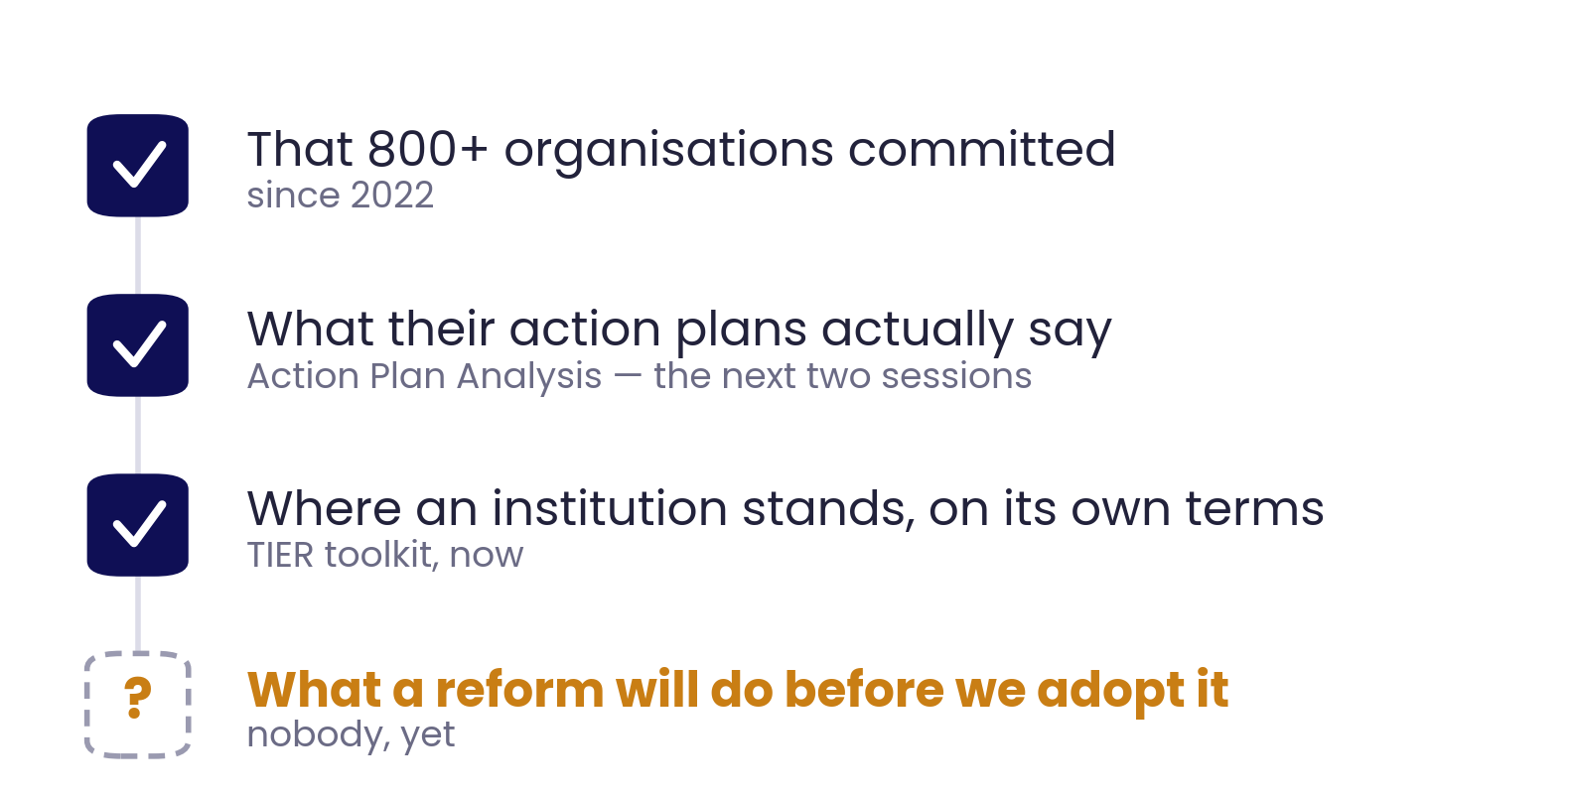
Enabler 1 : What we can see, and what we cannot
Signatory and action-plan figures: coara.org. Self-assessment toolkit: CoARA Working Group TIER. Action-plan analysis at scale: Chavalarias (CNRS) and Stroobants, this conference, 8 September 2026.

Slide 5
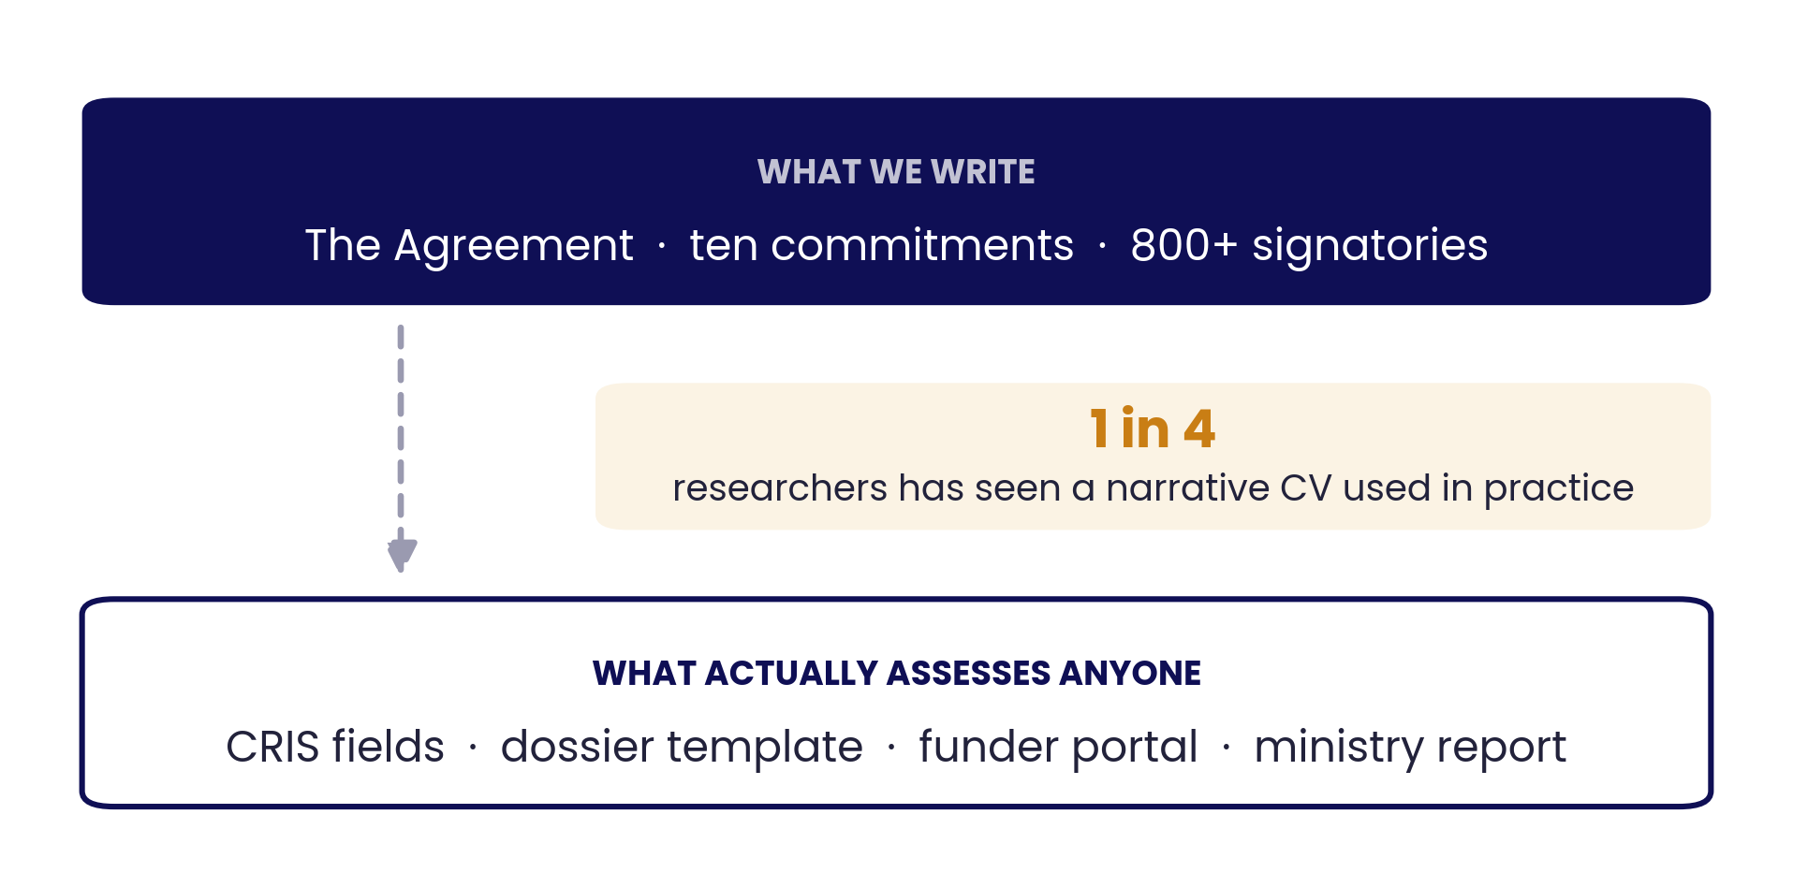
Enabler 2 : Where commitments start
Narrative-CV finding: CoARA TIER Working Group survey, n = 1,682, presented at the MCAA stakeholder dialogue, Brussels, 14 July 2026; unpublished. Data-layer example: Helmholtz Open Science Office.

Slide 6
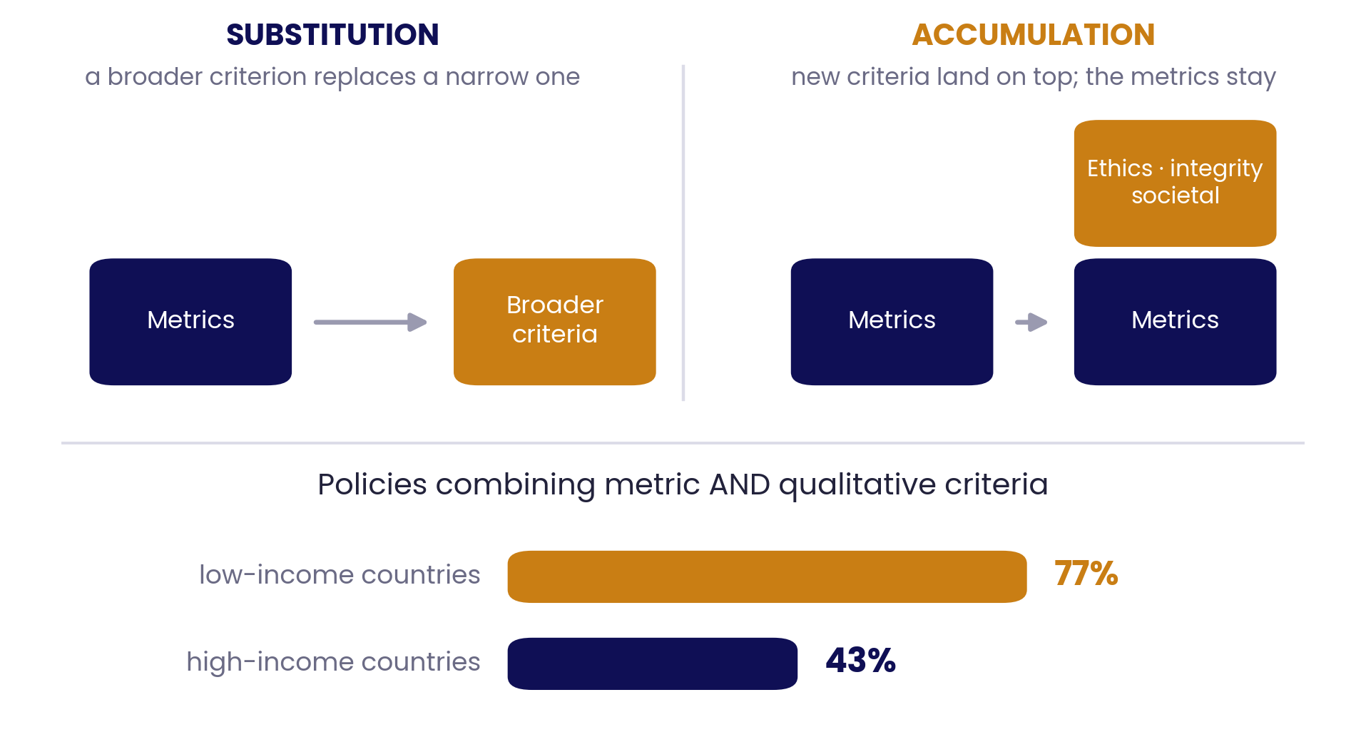
… and reform, as we practise it, adds
Preliminary analysis of the dataset behind Lim BH, D'Ippoliti C, Dominik M et al. (2025) Regional and institutional trends in assessment for academic promotion. Nature 638:459–468; not yet peer-reviewed.

Slide 7
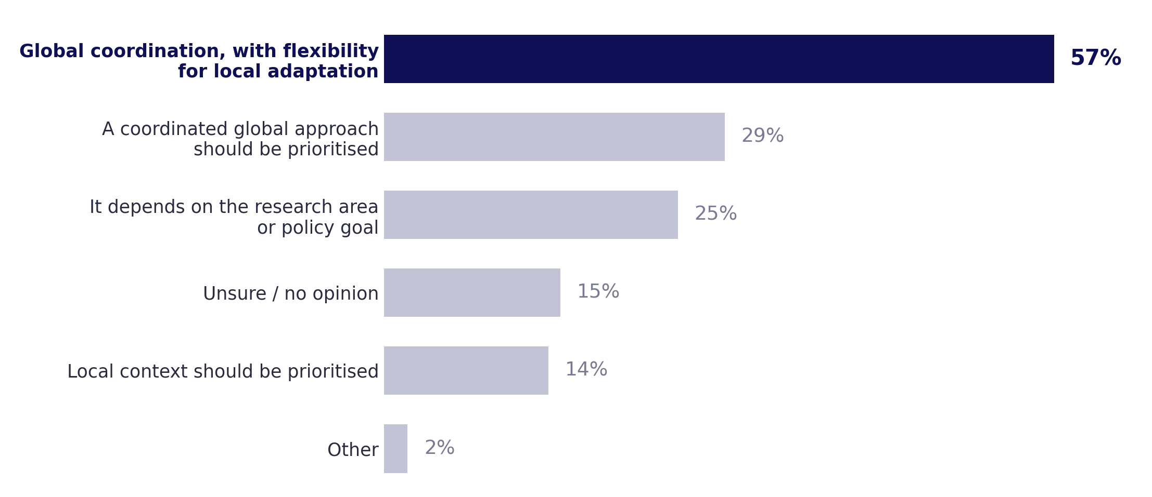
Enabler 3: What researchers are actually asking for
Multiple choice, so responses total more than 100%. MCAA survey, N = 622; adapted from presentation at “Rethinking Research Assessment: A Global Strategic Dialogue” meeting. Beijing, June 2026.

Slide 8
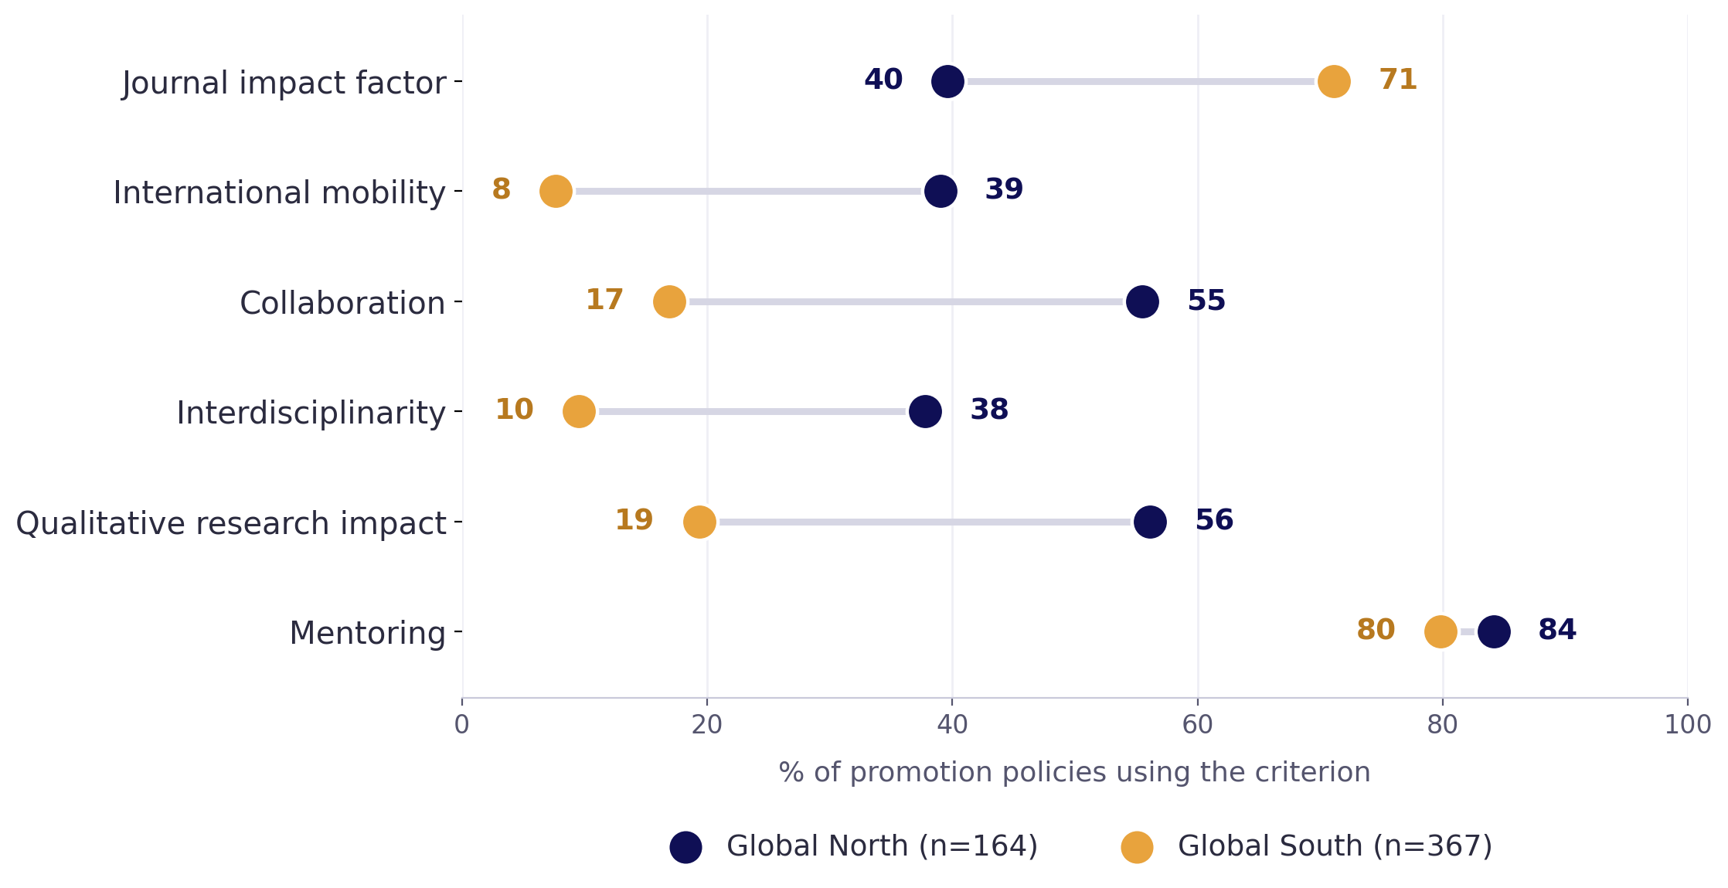
… and why it cannot simply be our template
Lim BH, D'Ippoliti C, Dominik M et al. (2025) Regional and institutional trends in assessment for academic promotion. Nature 638:459–468. Analysis set: 531 policies; unweighted policy-level prevalence.

Slide 9
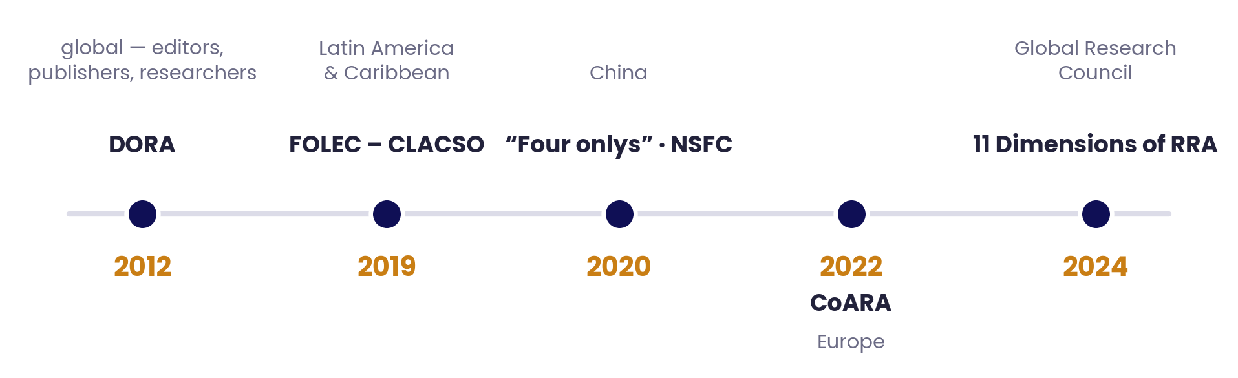
Enabler 4 : Five reform waves
DORA: ASCB Annual Meeting, San Francisco, 2012 (sfdora.org). FOLEC: clacso.org/folec. China: NSFC Department of Interdisciplinary Sciences, 2020. CoARA: Agreement on Reforming Research Assessment, 2022. GRC: 11 Dimensions of RRA, 2024.

Slide 10
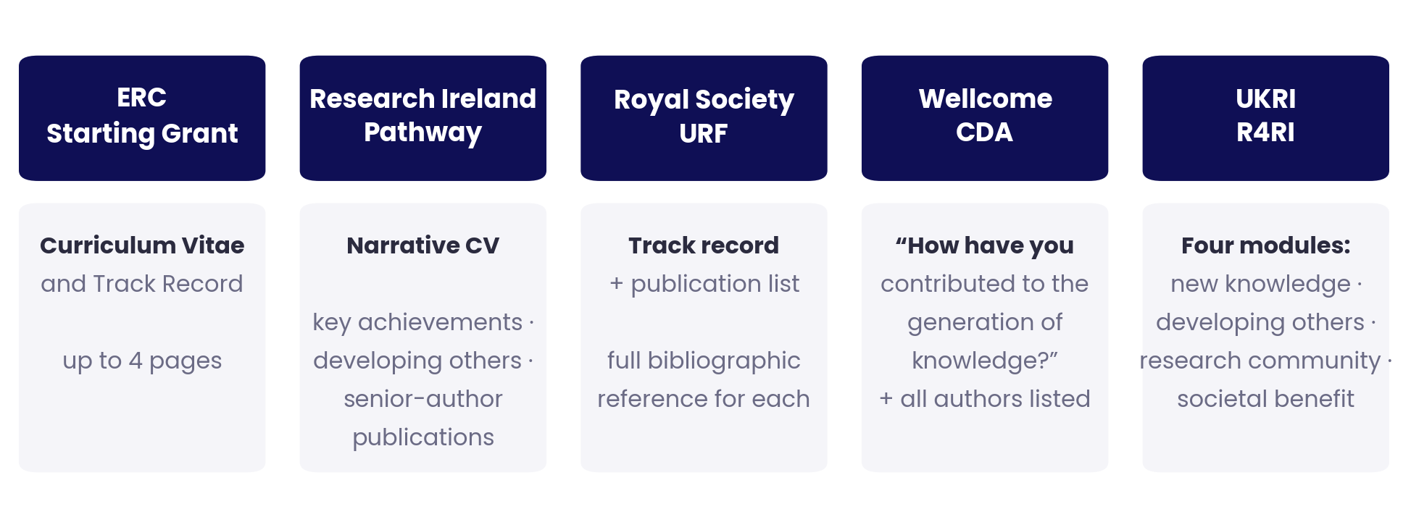
The test : nine funders, one year, one researcher
“…lead author, first author, and publications in journals being the main gauge of success”
— one of the five, in a 2026 call document, on what you must explain if you differ from it
Requirements and quotation taken from the 2026 call documents of the five schemes shown.

Slide 11
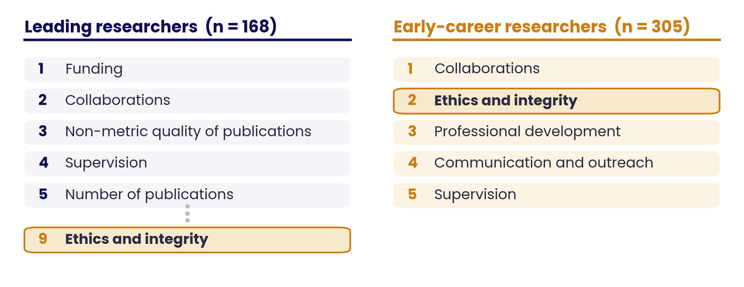
The reason I am optimistic
The people arriving already want what CoARA stands for
Helmholtz Open Science Office researcher survey, n = 1,145 across 18 centres, 2025 — unpublished; career-stage subsets as shown, per the EU Research Career Framework. Rank order only.

Slide 12
We have proved that reform can be built.
The question is whether it can be carried.
The instruments are being designed. Some of the partners we need are already in this room: DORA, FOLEC-CLACSO, the Global Research Council. Panel 2, is about the ones who are not.

