Slide 1
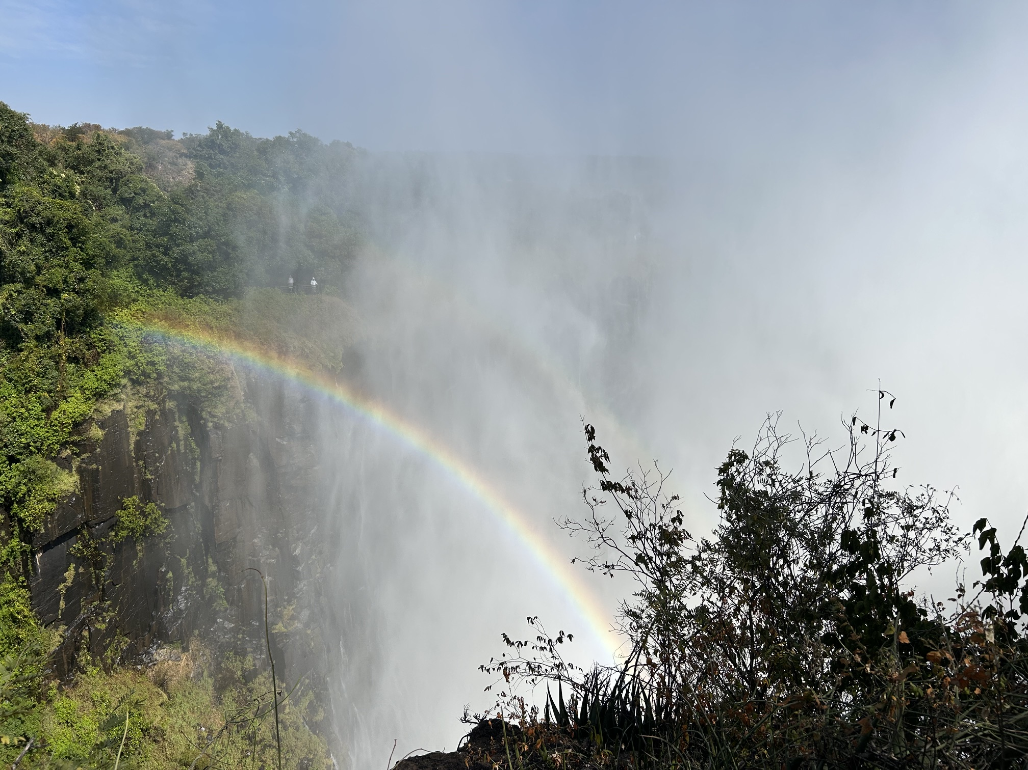
The Zambia Health Data Project:
Embedding Data Literacy in a Global Health Study Abroad Course
Jane Campbell (she/her)
Social Sciences and Data Literacy Librarian
College of Saint Benedict & Saint John's University
Notes:
Photograph taken by the author.

Slide 2
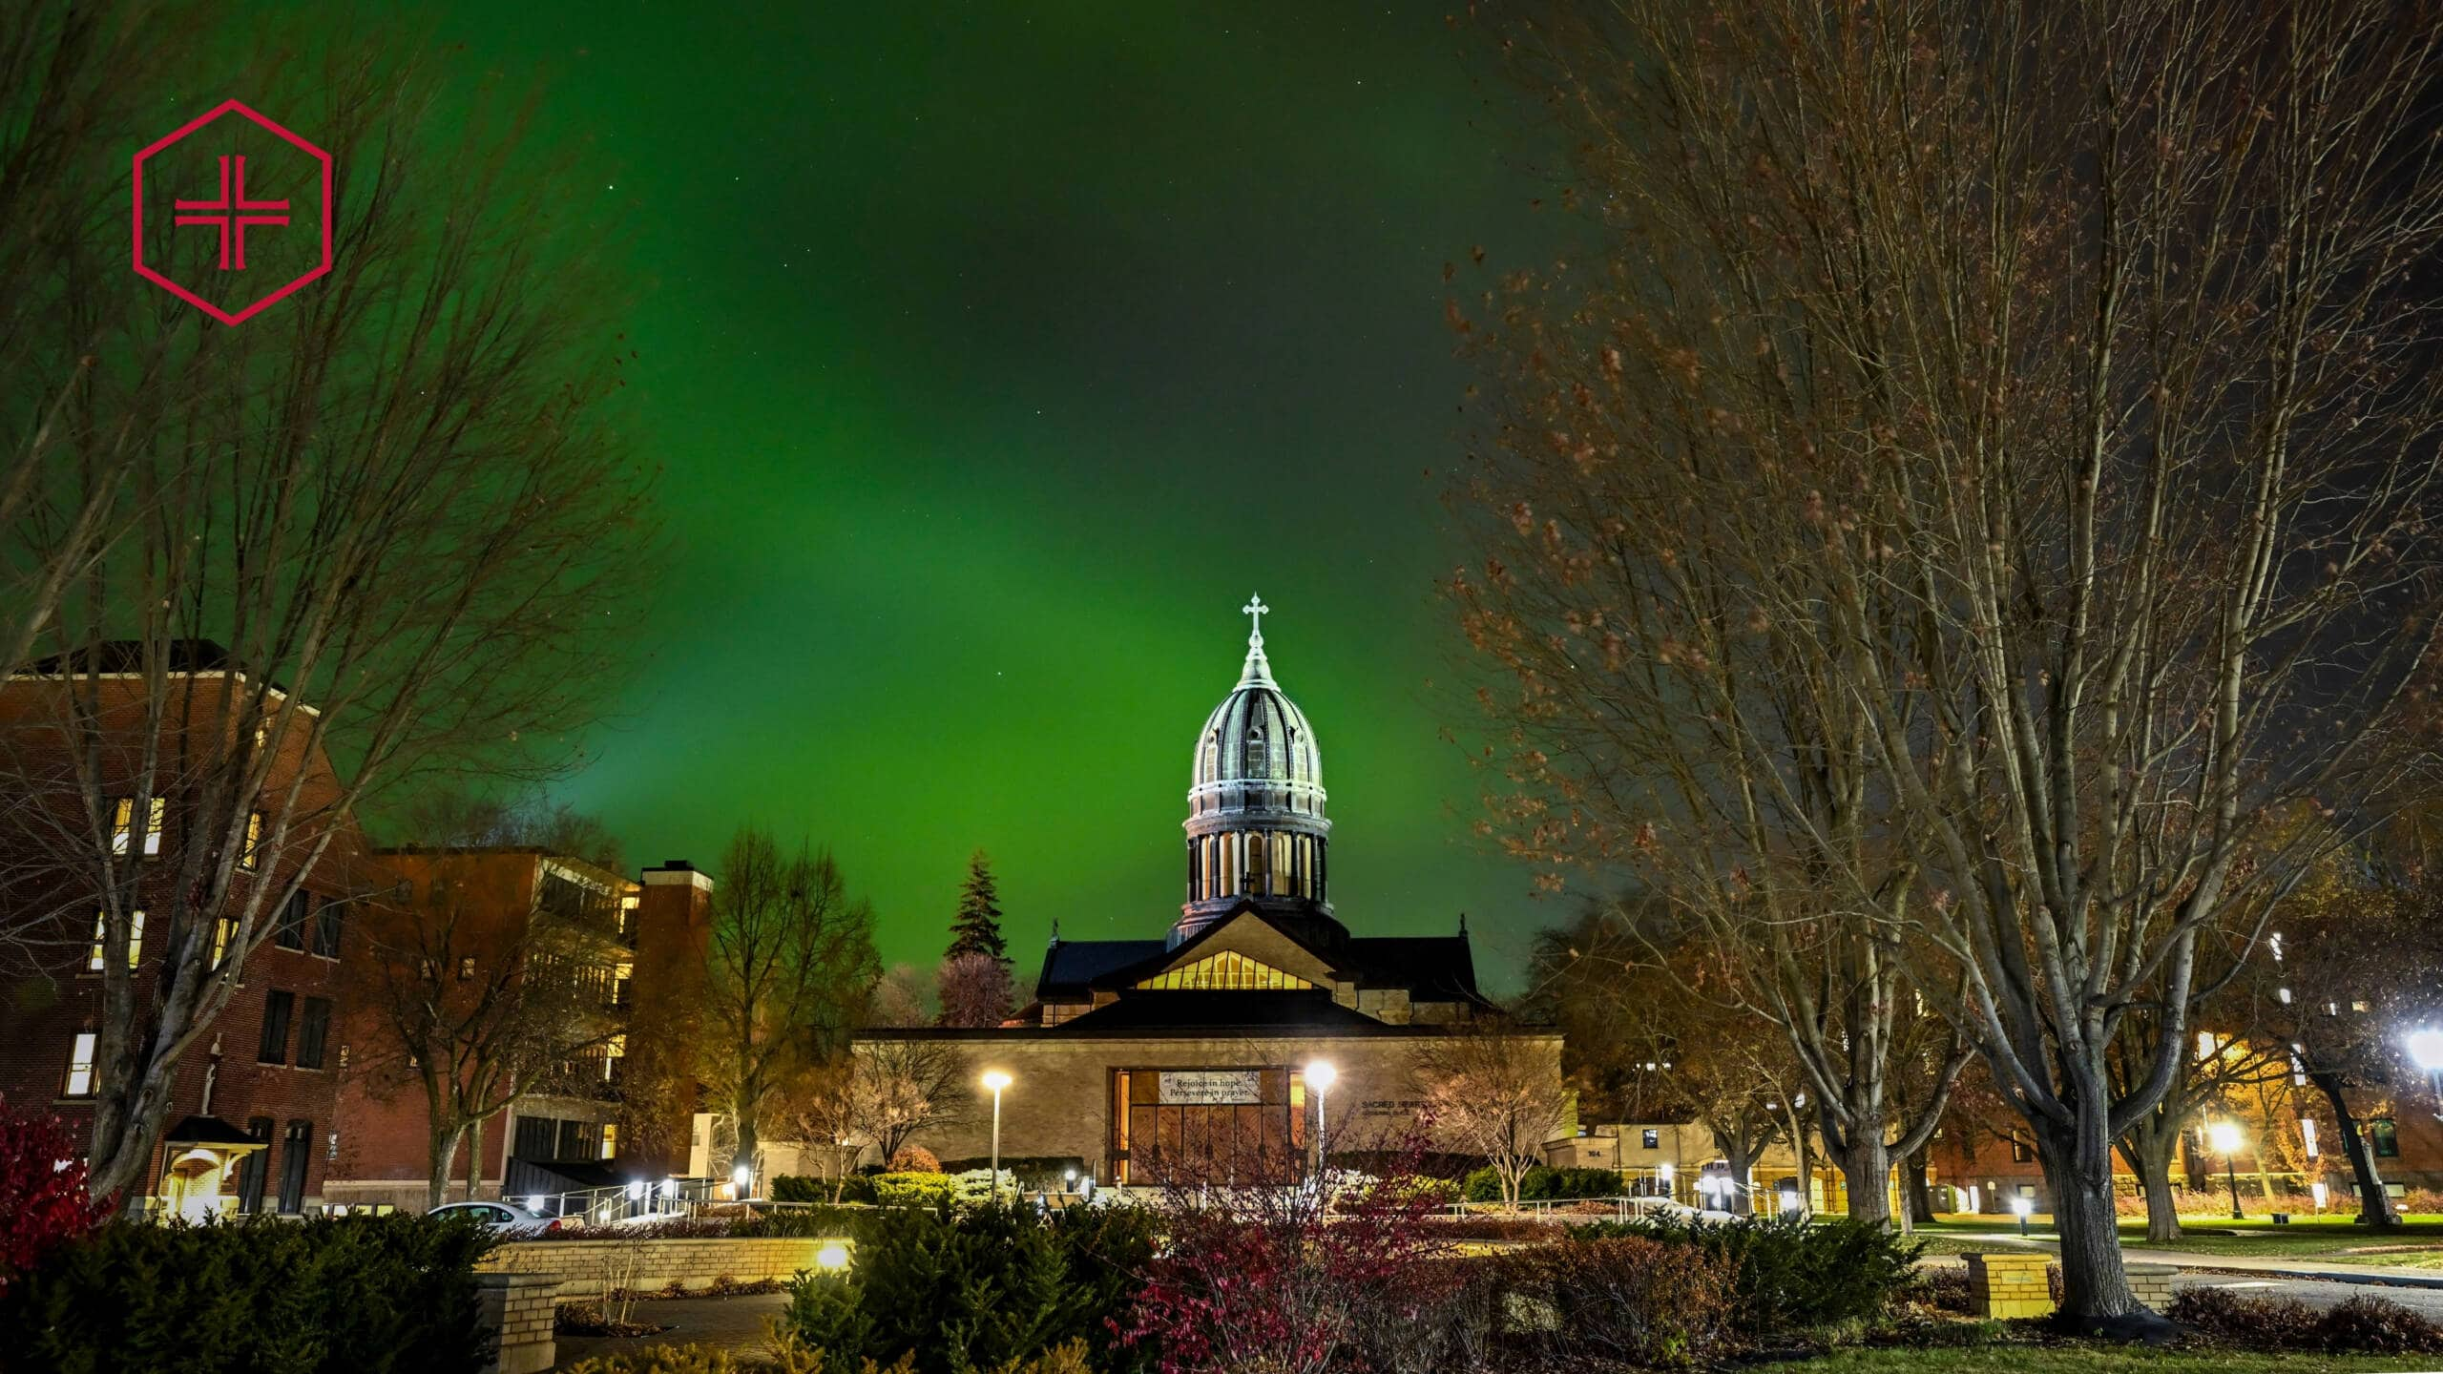

Institutional Context - CSBSJU
Small, private liberal arts college in central Minnesota
~2600 undergraduate students
Notes:
Photographs courtesy of CSBSJU Marketing and Communications.

Slide 3


Institutional Context - CSBSJU
Data literacy librarians hired August 2025
Focus on incorporating data literacy instruction

Slide 4
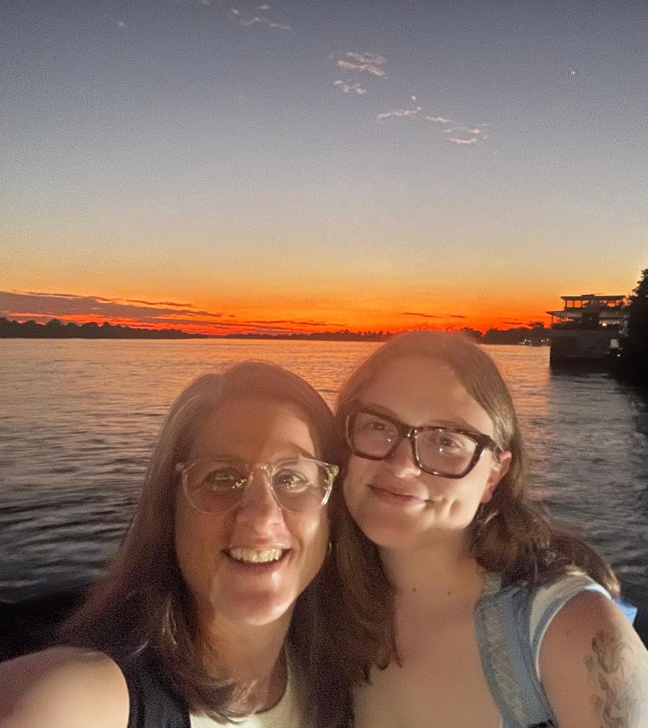
Course Context
Collaborator: Dr. Ellen Block, Anthropology
Learning outcomes:
Students will interpret how socioeconomic, historical, political, and biological determinants of health intersect to affect global public health in Zambia
Students will evaluate how cultural values and practices, as well as unequal structures, affect people’s experiences of health, illness, and healing in Zambia
Notes:
Photograph taken by the author.

Slide 5
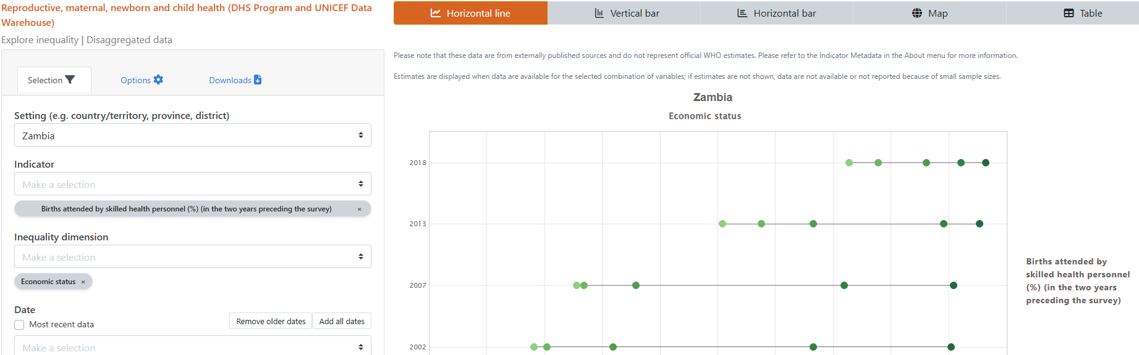
Project Description
Based on Diabetes Data Project – tool-based data visualization activities

Slide 6
Project Description
6 graphs, 6 health indicators
Encourage students to research cultural or systematic explanations for data trends

Slide 7
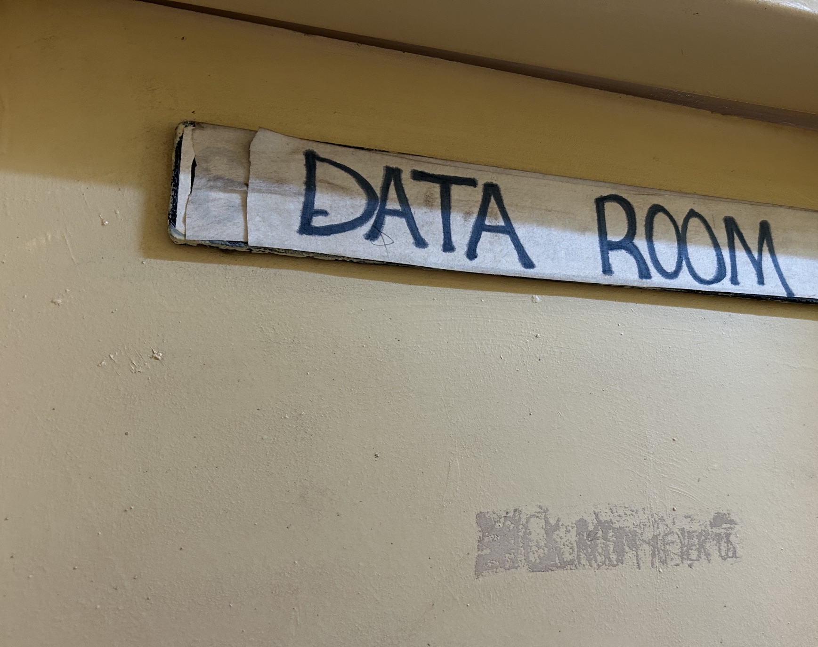
Project Implementation
80-minute data literacy video
Quick HEAT demo
Lots of in-class work time
Notes:
Photograph taken by the author.

Slide 8
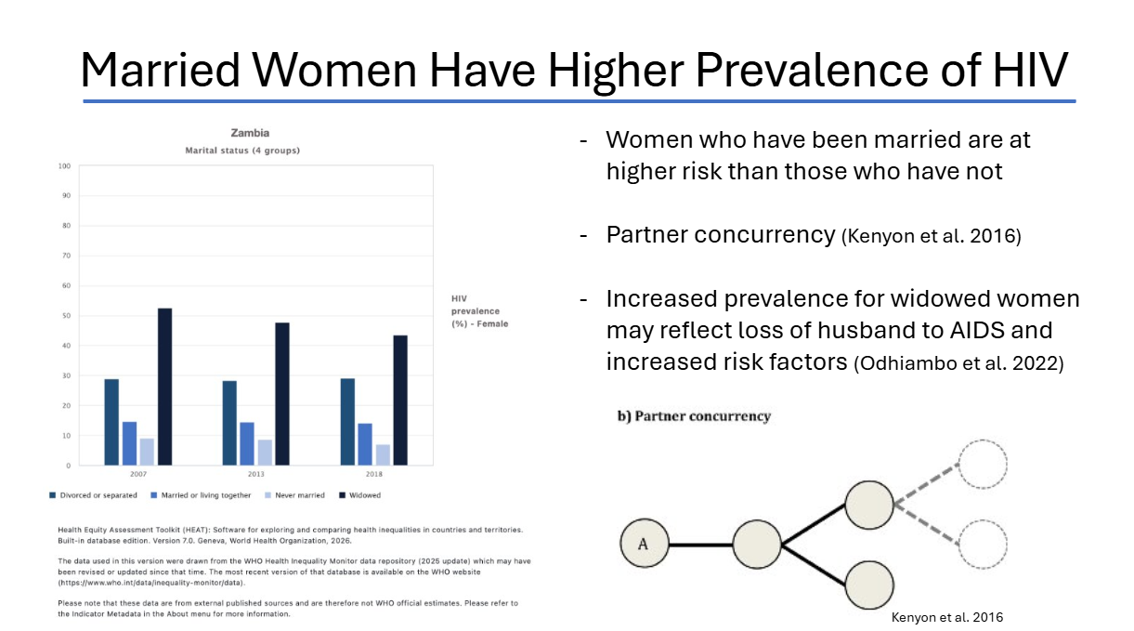
Student Examples
Notes:
Slide used with permission from students.

Slide 9
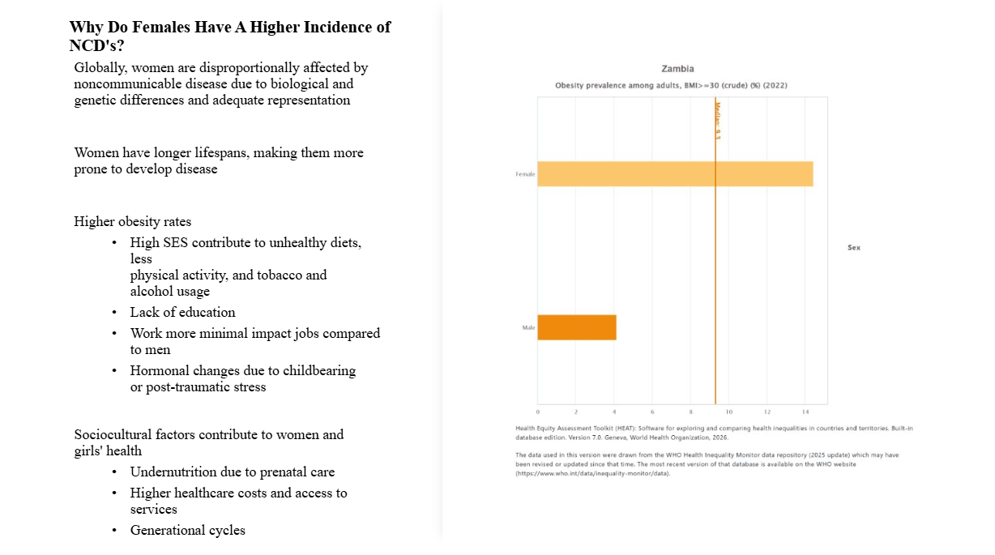
Student Examples
Notes:
Slide used with permission from students.

Slide 10
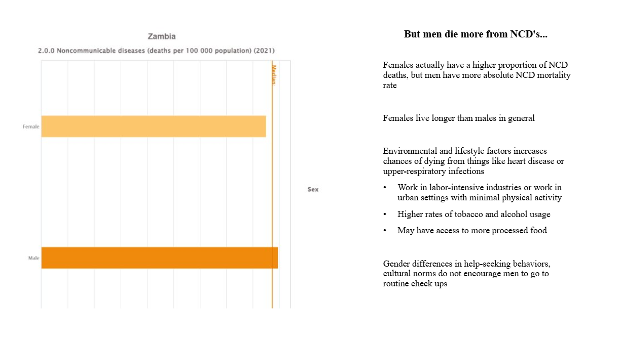
Student Examples
Notes:
Slide used with permission from students.

Slide 11
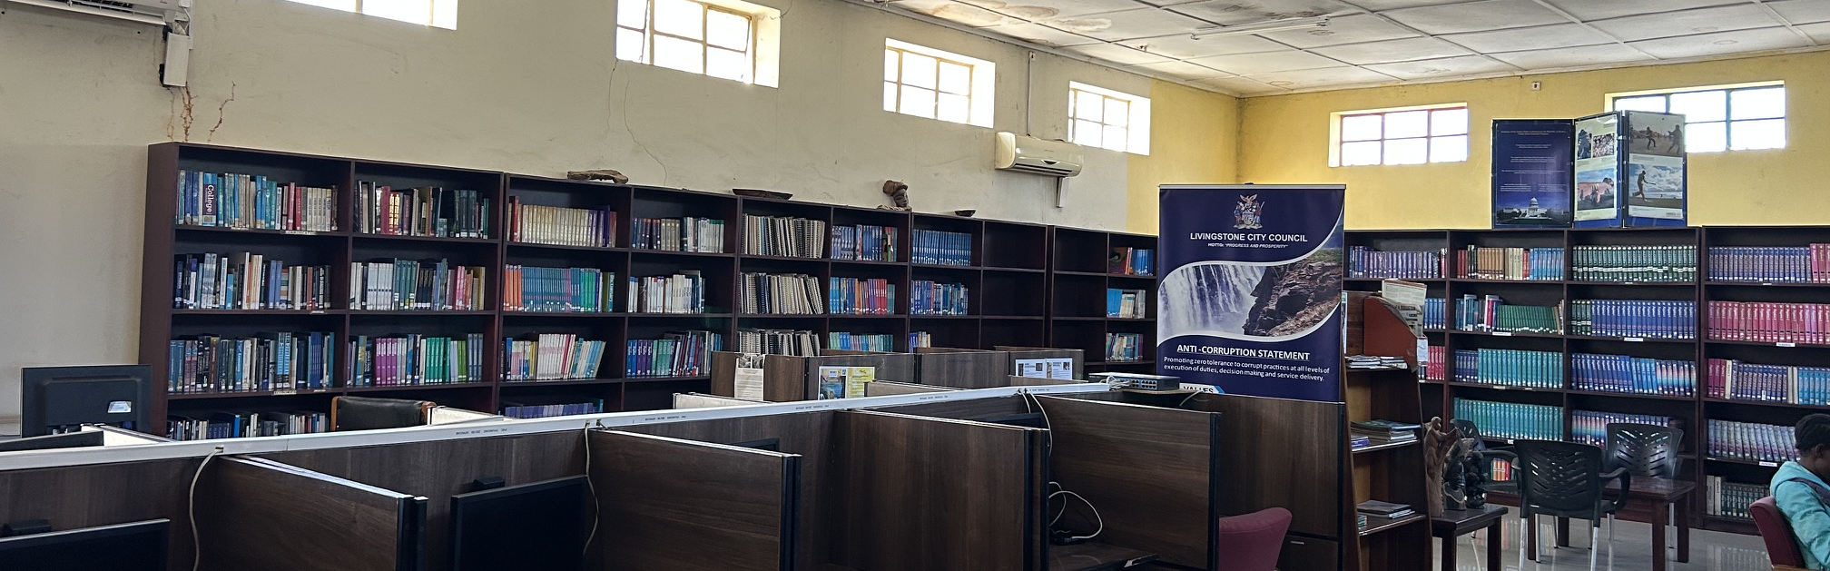
Assessment
(or lack thereof…)
Formal assessment: rubric-graded
Informal Assessment: anecdotal comments and observations
Notes:
Photograph taken by the author.

Slide 12
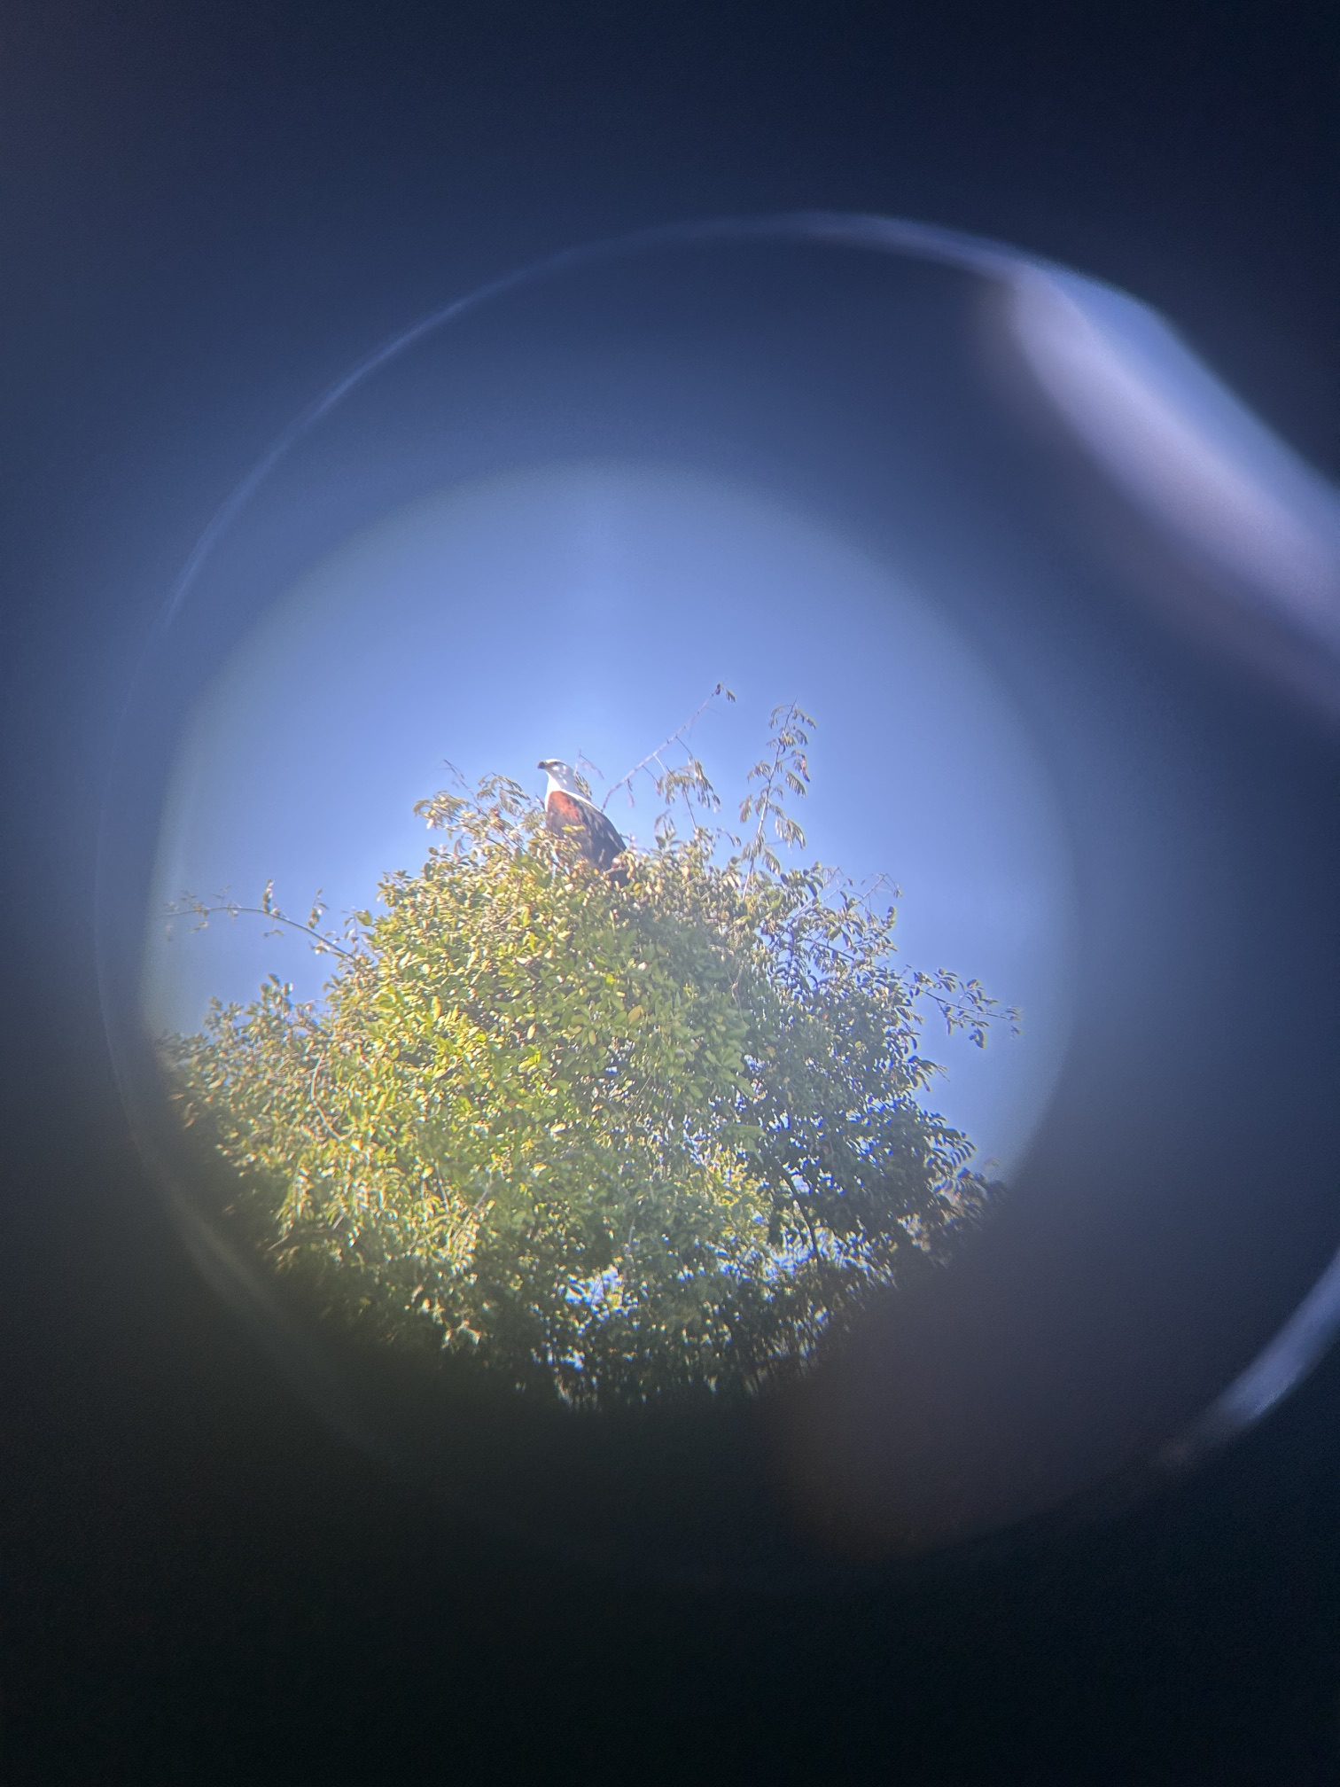
Takeaways
Easy, introductory, tool-based assignments are cool
Every tool has its quirks
More troubleshooting time would be nice
Could scale up with more rigorous requirements or different learning goals
Stay tuned for a similar assignment using PolicyMap!
Notes:
Photograph taken by the author.

