Slide 1

Geospatial Data Citation Generator
Facilitating Attribution,Transparency, and Reproducibility in Spatial Research
Big Ten Academic Alliance Geospatial Information Network (BTAA-GIN)
Data Citation Working Group
    Amanda Tickner, Ph.D. — Michigan State University
    Innocensia Owuor, Ph.D. — Purdue University (Presenter)
    Mēch Frazier — Northwestern University
    Susan Oldenburg — Rutgers University
Midwest Data Librarian Symposium
Purdue University
September 28, 2026

Slide 2
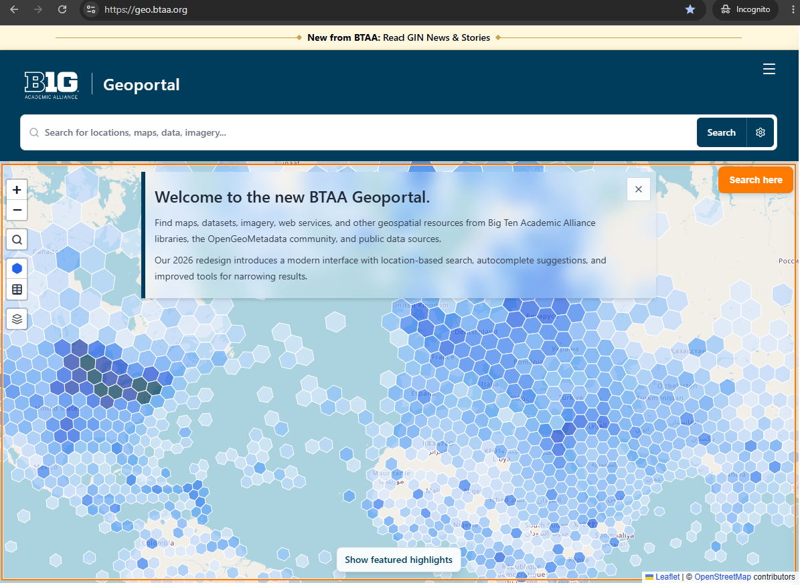
Geospatial Data Citation
INTRODUCTION & OVERVIEW
Centralized Data Discovery Platforms- The BTAA-GIN connects researchers to thousands of GIS datasets via a unified Geoportal
  While platforms simplify data access, standard citation frameworks struggle to handle complex spatial metadata.
Public GIS data is essential for modern spatial research, yet it remains severely under-cited in formal publications
Citation Deficit- In 20 Michigan EGLE datasets across top 30 search returns, only 4 formal citations were found via URL (2024 Pilot).
BTAA Geoportal Interface Screenshot

Slide 3
Problem Statement
Challenges in Geospatial Data Citation
Format Complexity
Geospatial datasets do not fit general citation generators:
Key Issues:
General generators may omit geospatial citation elements
Requires unique metadata (version, extent)
Many geospatial file types/formats
Inconsistent Practice
Spatial resources are frequently omitted or incomplete:
Key Issues:
Citation details left to end-user choice
Manual citation is time-consuming
User Knowledge Gaps
Scholars lack tailored tools for spatial attribution:
Key Issues:
Unaware of critical spatial citation elements
Lack of tools tailored to spatial data attribution

Slide 4
Why Geospatial Data Citation Matters
Ensuring Recognition, Discovery, and Research Integrity
Recognition & Funding
Uncited data prevents creators and distributors from showing impact and securing vital funding.
Discovery & Reuse
Missing metadata severely hinders scholars from finding, evaluating, or reusing valuable datasets.
Research Reproducibility
Formal citations provide a traceable link to the data, supporting research transparency.
Accountability
Proper citation create an audit trail which can help discover and examine errors when when results are unexpected.

Slide 5
Methodology
Metadata Fields and Data Formats Selection
Iterative Testing
Refining the generator through stakeholder evaluation:
Consolidated into a list of key identifiable formats and fields
User testing with GIS librarians
Export validation for Zotero & EndNote
Verification of resolvable DOIs/URLs; enable automatic & manual input
Environmental Scan
Comprehensive evaluation of existing citation practices across institutions:
Reviewed 40+ academic library guides
Reviewed citation styles to ensures broad compatibility across journals, book publishers
Schema Mapping
Citation elements were derived by examining how spatial data is created, stored, and cited:
Analyzed GIS data repository standards and data models
Software Formats: QGIS, ArcGIS, GDAL libraries
ISO 19115 Standard: Connected to official metadata practices

Slide 6
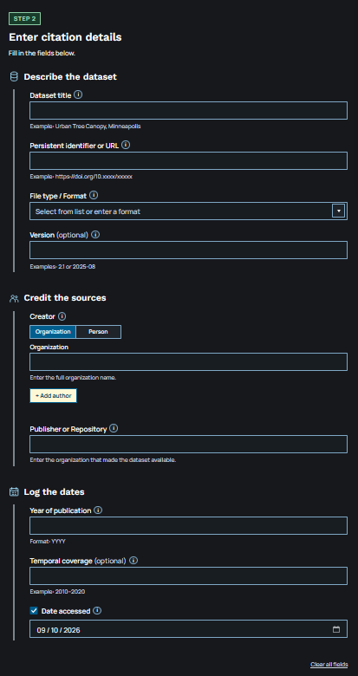
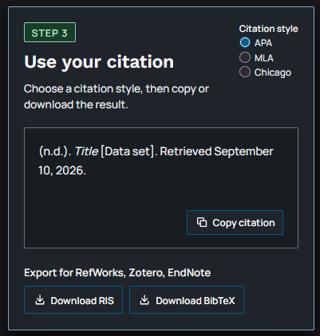
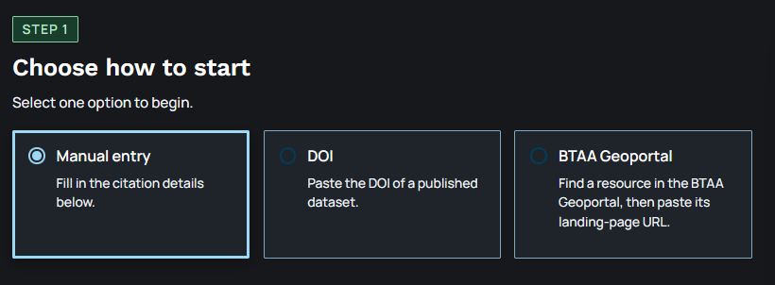
Citation Workflow
How to Use The Tool
1
Origin
2
Details
3
Export
Enter and review dataset descriptions, creator credits, publication year, temporal coverage, and access date.
Select APA, MLA, or Chicago style, copy the formatted text, or export RIS/BibTeX files for reference managers like Zotero, EndNote, and RefWorks.
Choose a citation starting point via Manual Entry, DOI lookup, or BTAA Geoportal URL auto-fill.
Demo DOI Link
https://tinyurl.com/geocite
https://gin.btaa.org/guides/data-cite/

Slide 7
Discussion & Impact
Benefits of the Geospatial Data Citation Generator
Efficient Citation Creation
Automatically retrieves metadata from DOI
Manual versions allows for making corrections or updating metadata
9 fields –identify, locate, evaluate, credit, and reuse data
.
Flexible File Formats and Citation Styles
Supports 23 data formats and various citations styles
Exports citations for RefWorks, Zotero, and EndNote
Easy to Integrate with Artificial Intelligence
Contains standardized fields in a form that AI systems can read reducing the risk of fabricated citations
FAIR Data Support
Findable- records DOI/ URL used locate datasets
Accessible: Includes DOI/URL for retrieving the data
Interoperable: Uses consistent metadata fields
Reusable: Documents the data lineage
"Data collection is the most resource-intensive part of geospatial management. This tool helps to establish data as a legitimate scholarly contribution with measurable impact."

Slide 8
Launch & Future Directions
Promotion & Outreach
Launched in Spring 2026
The tool is actively being promoted across key academic stakeholders to drive adoption and engagement:
Faculty engagement across institutions
Student workshops and research integration
Librarian-led outreach and training programs
Future Directions
Custom Formats
Exploring custom geospatial citation formats designed to better capture unique spatial attributes and metadata.
Expansion & Standards
Developing dedicated QGIS software plugins
Conducting further user testing
Addressing formal software citation standards to improve overall research replicability
QR code to generator

